Slide 1

ORD RESEARCH RESPONSE TO COVID-19
Dial in: 1 (562) 247-8422
Access Code: 333-396-757
Slides in “Handout” Tab
Office of Research & Development
March 19, 2020

Slide 2
PRESENTERS (in order of presentations)
Rachel Ramoni, DMD, ScD – Chief Research and Development Officer (CRADO)
Grant Huang, MPH, PhD – Acting Deputy CRADO – Enterprise Optimization
Molly Klote, MD – Director, Office of Research Protections, Policy and Education
Wendy Tenhula, PhD – Deputy CRADO
Victoria Davey, PhD, MPH, RN – Associate CRADO for Epidemiology and Public Health

Slide 3
OUTLINE
Overview of ORD activities in response to COVID-19
Regulatory / Human Subjects Protections
  ORD Administrative Hold Memo
  Compassionate Use / Expanded Use
ORD Frequently Asked Questions
Research Coordination and Opportunities
General Q&A
Note: Each section will follow with a brief Q&A session for the respective topic.

Slide 4
BEFORE STARTING…
COVID-19 is affecting a lot…including this webinar.
Materials will be available afterward.
Webinar is being recorded.
Presentations provide an overview of ORD activities.
  Topics will not be comprehensive nor will processes be perfect as things develop.
Questions posted but not answered on the webinar will be recorded.
Contact ORD through ORDCOVID19@va.gov

Slide 5
COMMENTS FROM THE CHIEF RESEARCH AND DEVELOPMENT OFFICER

Slide 6
CHRONOLOGY
Jan 31, 2020 – Discussion with National Research Advisory Council Chair (NRAC) on VA Research response on COVID-19
March 4, 2020 – NRAC briefing with VA Acting Deputy Officer for Public Health
  ORD contacted about support for other agency efforts
March 5, 2020 – ORD begins formal organizational efforts
  Research coordination, field impact, ORD staff safety/health
March 19, 2020 – ORD webinar for field

Slide 7
ORD COVID-19 RESPONSE TEAMS
Rachel Ramoni, DMD, ScD – Chief Research and Development Officer (CRADO)
Grant Huang – Dep CRADO – Enterprise Optimization (Acting)
Molly Klote – Director, ORPPE
Wendy Tenhula – Dep CRADO
Marisue Cody – Director, ORD Operations
Amanda Garcia, Mary Kelleher, Mitch Mirkin
Public Health
Pathology/ Lab Med
PBM
_____
Privacy
OGC/STAR
ISSO-RSD
ORO
Research Steering Committee
Coordination/Review of ORD supported research activities on dx, tx, prev & mgmt.
Robert Bonomo
Sheldon Brown
Scott DuVall
Sarah George
Mark Holodniy
Field Research Ops
Coordination & disseminate info to maintain research COOP & safety of study participants; help with understanding implications of COVID-19 activities/decisions
Tony Laracuente
Mike Fallon
Terri Gleason
Holly Henry
Sharon Jacky
Kari Points
Maria Rodriguez
ORD Staff Safety & COOP
Protect ORD staff and ensure COOP within VACO
ORD Service AOs
ORD Employee Engagement Team
Vicky Davey
(interagency)
Jane Battles
(ORD/VA)
Biospecimen Collection Protocol
Clinical Trials
- tx, prev, diag
Other (e.g., observational, data/epi, HSR)
Draft 3/18/2020

Slide 8
ORD COVID-19 RESPONSE TEAM
ORD members
Rachel Ramoni
David Atkins
Jane Battles
Marisue Cody
Vicky Davey
Amanda Garcia
Scientific Steering Committee
Sheldon Brown (Bronx)
Robert Bonomo (Cleveland)
Scott DuVall (Salt Lake City)
Sarah George (St. Louis)
Mark Holodniy (Palo Alto)
  Grant Huang
  Mary Kelleher
  Molly Klote
  Mitch Mirkin
  Wendy Tenhula
Priorities:
Coordinating / maximizing VA research contribution to national effort
Support field operations & responses to COVID-19 and impacts on research
ORD staff safety / health

Slide 9
ORD COVID-19 RESPONSE TEAM
Daily team briefing reviews activities and discusses progress on activities
  Research, Field ops, ORD Staff
  Identifies other groups or VA / VHA offices to engage
Actions and/work groups tasked to members or other ORD/field staff

Slide 10
CONTACTING ORD
ORDCOVID19@va.gov
ORD COVID-19 team members will help direct questions to appropriate subject matter expert(s) or try to best respond
  Please provide context or appropriate subject heating – many efforts being directed to mailbox.
Questions and responses are tracked to help with consistency for all research community.

Slide 11
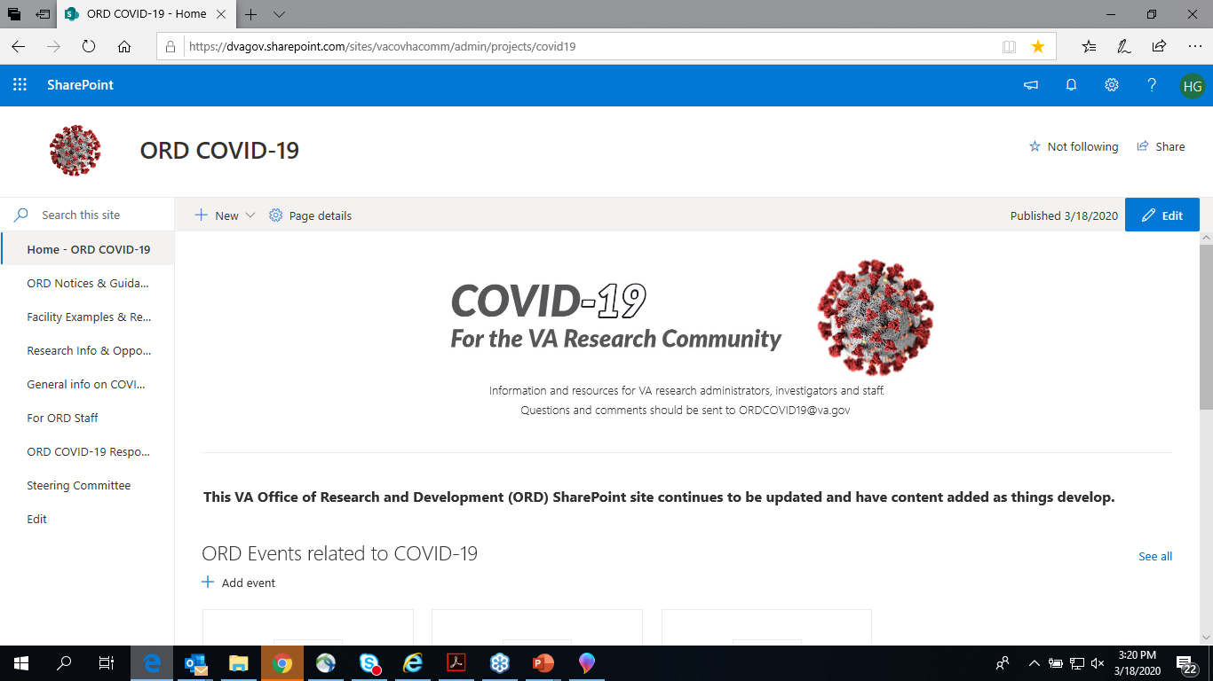
ORD COVID-19 SHAREPOINT SITE
https://dvagov.sharepoint.com/sites/vacovhacomm/admin/projects/covid19

Slide 12
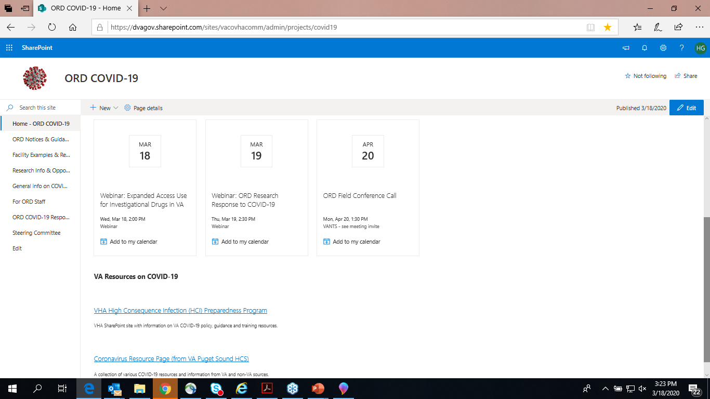
Upcoming
Events
VA Resources

Slide 13
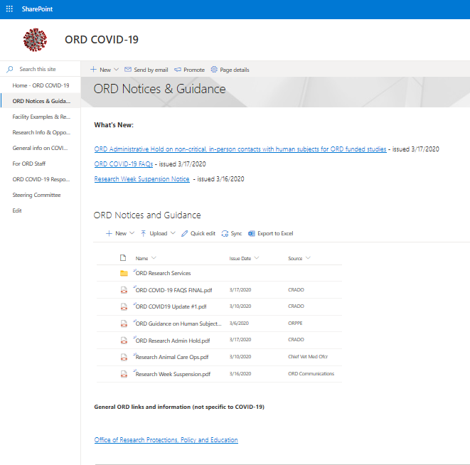
ORD Notices with issue date and source listed

Slide 14
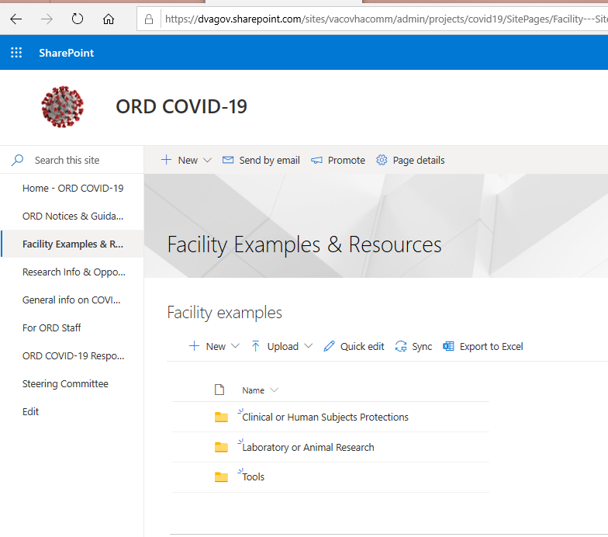
Helps with seeing efforts and examples from other facilities.

Slide 15
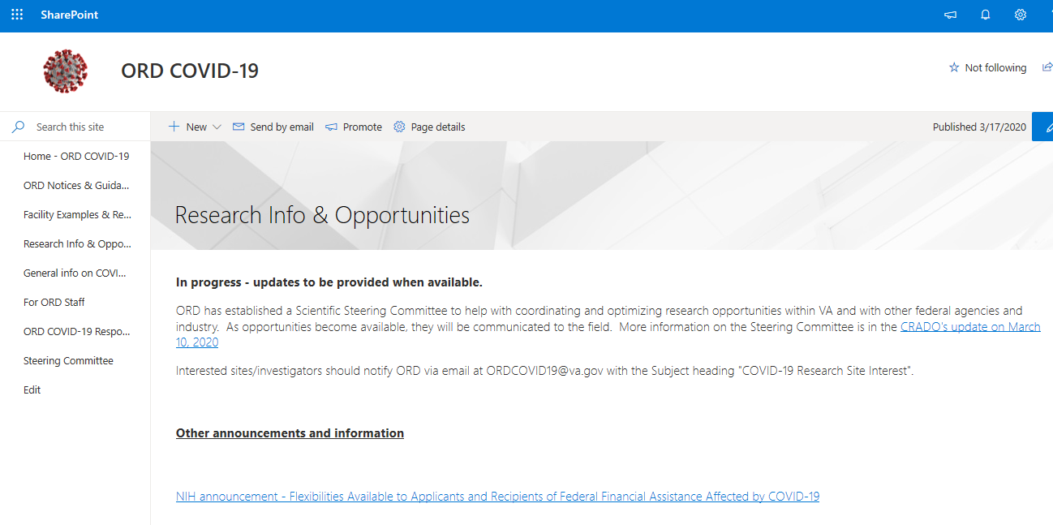
Announcements on VA, other federal or industry research opportunities.

Slide 16
TAKE AWAYS
Become familiar with information and resources made available
ORD is focused on coordinating activities to maximize VA research contribution with VA and nationally
ORD is committed to supporting the field in their research activities and responsibilities affected by COVID-19
ORD authority is not all-encompassing but it can work with other offices to develop solutions

Slide 17
Regulatory Issues and Human subjects protections

Slide 18
CLINICAL SCREENING PROCEDURES / MODIFYING STUDY PROCEDURES
Issued March 6, 2020
New mandatory VHA facility level COVID-19 clinical screening procedures are not considered part of “IRB approved procedures”
  screening procedures do not constitute a change in IRB-approved research procedures unless
    data collected under mandatory screening is incorporated into study plan as part of the research

Slide 19
CHANGES IN RESEARCH PROCEDURES
Changes in IRB-approved research procedures must be reported to the IRB
  Changes may not be implemented prior to review and approval by the IRB except when necessary to eliminate apparent immediate hazards to the subject
(Common Rule (38 CFR §16.108(a)(3)(iii)); FDA regulations (21 CFR §56.108(a)(4))

Slide 20
PROTOCOL AMENDMENTS
Protocol amendment needed if it is anticipated that immediate changes made to the study to eliminate apparent immediate hazards will be sustained for a duration that would practicably allow for an amendment to cover such changes
Protocol changes may require temporary hold on all study procedures
  PIs should communicate with IRB, funding agency/sponsor

Slide 21

ADMINISTRATIVE HOLD ON ORD FUNDED STUDIES
Issued: March 17, 2020
Goals:
  Protect safety and health of Veterans, VA staff and the community
  Reduce the burden on the VA health care system
Scope: Non-critical, in-person, ORD-funded human research subject interactions
  Inpatient or outpatient
Duration: Until further notice

Slide 22
CRITICAL INTERACTIONS
Critical interactions are defined for the purpose of this memorandum as interactions that involve a potentially lifesaving intervention or an intervention that is required to maintain essential activities of daily living or subject well-being, including mental health and suicide prevention research that cannot occur remotely.
  Examples: IV oncology treatment drug delivery, suicide prevention studies

Slide 23


WHAT WORK CAN and CAN’T BE DONE?
Can’t Continue
Can Continue
In-person recruitment/ enrollment, including screening visits
In-person interaction or intervention with human subjects
In-person follow-up
* Unless it is a critical interaction
Animal & laboratory studies
Studies that do not involve interactions with human subjects:
  Some exempt or expedited review studies (e.g., online survey research, analysis of existing clinical data)
  phone or internet-enabled recruitment, surveys & follow-up.
Interventions using phone, video telehealth, internet, secure messaging or other tech-enabled applications

Slide 24

THINGS TO DO
Key principle = social distancing; avoid contacts when possible
  Study subjects and staff
  R&D Committees, IRBs
Report administrative holds to oversight committee(s)
  Single notice acceptable if allowed by local SOPs
Try extending policy to non-ORD funded studies if no local policy already in place
Communicate situation with funding groups
    Review FAQs and ask for local guidance before contacting ORDCOVID19@va.gov
This Photo by Unknown Author is licensed under CC BY-SA

Slide 25
Expanded Access / Compassionate Use

Slide 26
Expanded Access Use of for Investigational Drugs in VA: Focus on COVID-19
More details provided in webinar given on March 18, 2020
Recording to be posted at: https://www.research.va.gov/programs/orppe/education/webinars/archives.cfm
Materials also to be uploaded on ORD COVID-19 SharePoint site.

Slide 27
Common Pathways for Use of Drugs and Biologics
U.S. Drugs and Biologics
Approved Drugs and Biologics
Investigational Drugs and Biologics
(Non-Approved)
Use According to FDA Marketed Label
Off Label Use of Approved Drug
Commercial and
Non-Commercial Investigational New Drug Applications
Expanded Access
Right to Try

Slide 28
What Research Committees or Subcommittees are Required to Review or Approve When a VA Physician Wants to Request an Investigational Drug or Biologic Related to COVID-19 Through Expanded Access?
Emergency IND
No Prospective IRB Approval
IRB Notification Required 5 Working Days After Beginning Administration
No VA Research and Development Committee approval
Non-Emergency IND
-Prospective IRB Approval Required
- Prospective VA Research and Development Committee approval Required
* Designated Review can be used when a single patient use is approved by the IRB Chair or another appropriate IRB voting member as permitted by FDA.

Slide 29
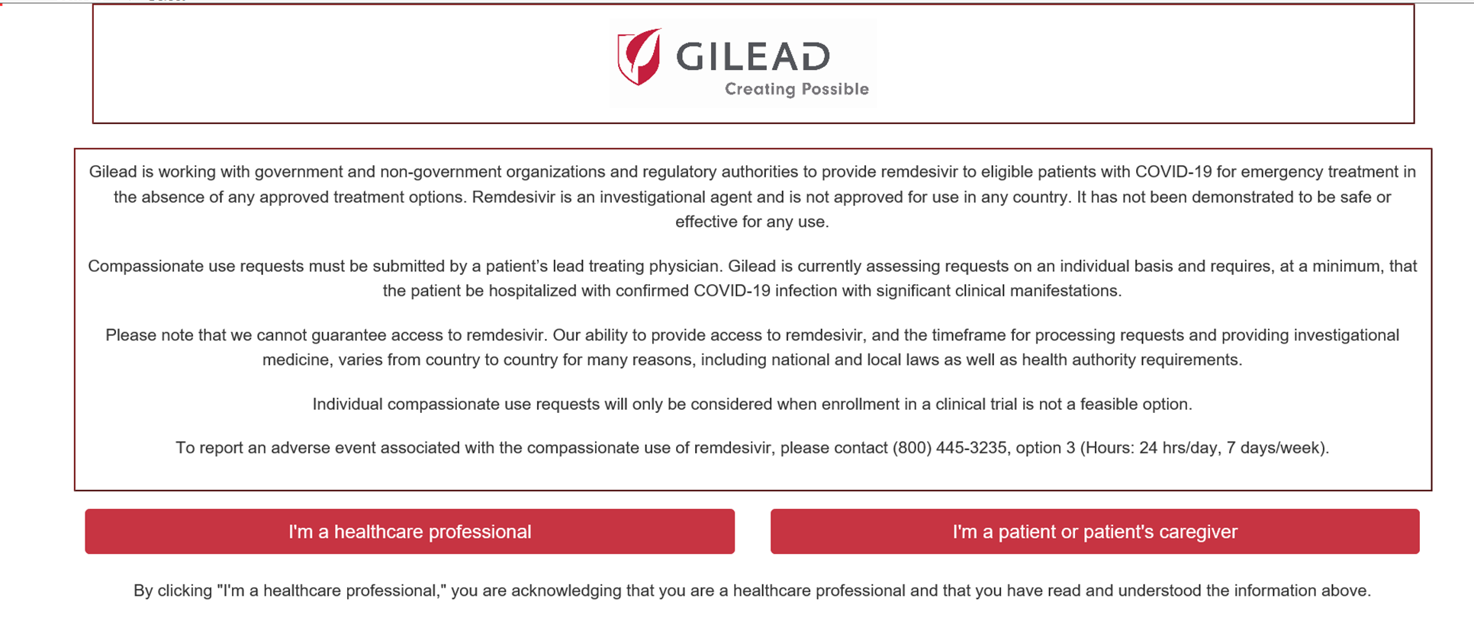
The Expanded Access Program to Remdesivir
(Gilead Sciences, Inc.)
Gilead is currently only allowing access to Remdesivir:
  Clinical trials
  Expanded access: Emergency IND
Requests must be made by the patient’s lead treating physician.
Requests must be made through the Gilead portal at https://rdvcu.gilead.com/.

Slide 30

Support Center for Facilitating Questions about Expanded Access Uses of Investigational Drugs and Biologics: COVID-19
ORD is staffing a dedicated support center to assist VHA Facilities with resolution of issues related to expanded access (emergency and non-emergency) uses of Investigational Drugs and Biologics related to COVID-19.
ORD is collaborating closely with Pharmacy Benefits Management (PBM) and other program offices as part of this support center.
The ORD Expanded Access support team can be contacted at COVIDExpandedCoord@va.gov
If any research coordinator or RCO is interested in volunteering to help please contact the COVIDExpandedCOord@va.gov mailbox.
We will train YOU!

Slide 31
What about Medical Centers without an IRB?
ORO has created a “VA Special Assurance” for this COVID outbreak and all medical centers without research programs are invited to get a Special Assurance.
  The Baltimore VAMC R&DC will serve as the R&DC for all
  Volunteer Research pharmacists will assist local clinical pharmacists
  The ORD Expanded Access coordinators will help the local providers
  The VA CIRB will serve as the IRB for all VAMC without an IRB

Slide 32
Summary
With the current COVID-19 pandemic, we are expecting different investigational drugs and biologics to be made available through an expanded access pathway.
Multiple program offices and VA Medical Facilities are working together to support all VA Medical Facilities for use of investigational drugs and biologics related to COVID-19 made available through expanded access.
We are going to ask ALL expanded access requests whether you use our support group or not to record those uses on a sharepoint site that is being established. More to follow.

Slide 33
Frequently Asked QUestions

Slide 34
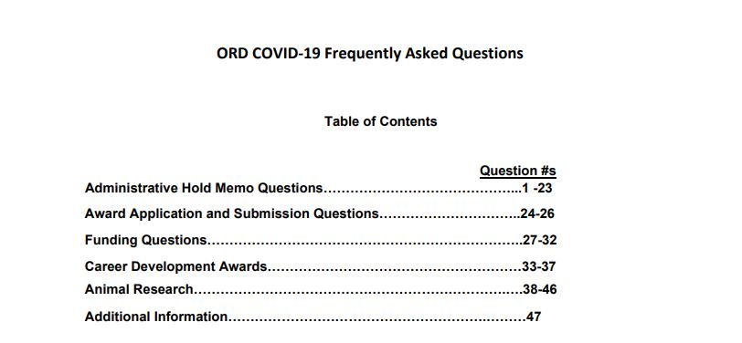
ORDCOVID19 mailbox – MAIL CALL
Incoming messages triaged:
Regulatory
Field Operations
Funding
Research Interests
Developed into FAQ Document

Slide 35
FIELD OPERATIONS
If research personnel paid on an IPA are unable to work during COVID-19 related laboratory closures will they continue to be paid?
Under the IPA agreement, payment is determined by the institution for whom the employee works, and continued salary payment would be based on local policies.
What is VA’s position on maintaining operations in the animal facility?
The research animals in VA facilities must always be properly cared for, which includes provision of food, water, clean housing, and veterinary care as needed. The same mindset of fully protecting Veterans in the hospital should be in place for the research animals.

Slide 36
FIELD OPERATIONS
What do I do if my local facility leadership implements a more restrictive research policy?
The medical center director has final authority over actions occurring at his/her facilities. Please notify your ORD funding service or extramural research sponsor if additional restrictions are placed on your research project.
This authority includes determinations about essential staff, teleworking and employee pay
  General HR guidance can be found here:
Human Resources Emergency Resource Center https://vaww.va.gov/OHRM/Worklife/Pandemic/

Slide 37
STUDY MODIFICATIONS
When do I need to request Project Modifications (PMO)?
PMO Required:
Change in specific aims
Change in methods
Change in budget (urgent)
PMO Not Required At This Time:
Change in effort by PI resulting from COVID-19 impacts
Change in duration / project extensions

Slide 38
BUDGET EXTENSIONS
If a study is unable to continue operations due to COVID-19 facility closures, will ORD approve study budget extensions?
ORD will accept and review requests to provide additional funding at the end of the award period. At that time, the request should be submitted as a Project Modification (PMO).
In the meantime, all investigators are urged to use resources wisely especially as study activities are on hold.

Slide 39
RESEARCH SERVICE CONTACTS
Biomedical Laboratory (BLR&D): VHABLRD-CSRD@va.gov
Clinical Science (CSR&D): VHABLRD-CSRD@va.gov
Health Services (HSR&D) or QUERI: VHACO.HSR&D.ProjectModifications@va.gov
Rehabilitation (RR&D): rrdreviews@va.gov
Million Veteran Program (MVP): MVPComms@va.gov
Cooperative Studies Program (CSP): CSP@va.gov
Career Development Awardees: vhacadereview@va.gov

Slide 40
RESEARCH INTERESTS
If I have a good idea for a COVID-19 research, what should I do?
We are counting on the field to come up with good ideas. We would like you to submit your ideas to ORDCOVID19@va.gov. We need to coordinate efforts that are alike in order to coordinate and maximize the VHA research response.
Does ORD have plans to fund research on COVID?
Solicitation for rapid research projects funded by HSR&D and CSR&D released 3/18 with first round due 4/6. We are most interested in studies that can be executed quickly and inform current practices. Follow guidance in RFA about local approval processes.

Slide 41
Rapid Response Research Projects (CSR&D, HSR&D)
Funding announcement released March 18, 2020
  Jumpstart research efforts by supporting work related to COVID-19
    Planning projects (“preparatory to research activities”)
    Short-term pilots
    Data analysis projects
Projects are NOT subject to administrative hold/stand down
Projects must not interfere with the mission critical work of VA clinical and operations partners in their response to COVID-19
  Do NOT reach out to VA clinical operations leaders or national program offices
  PIs should discuss plans with local facilities, including ACOS-R), to avoid undue imposition on clinical systems
    Formal letters of support are NOT required

Slide 42
Rapid Response Research Projects – Logistics
Timeline, Review, & Award
  First submissions due Monday, April 6 (decisions announced by May 1)
    Subsequent applications reviewed on a rolling basis through July 1, 2020
  Projects are expected to start as soon as feasible after award
Application
  Concept paper (3 pages)
  Summary budget table & budget justification
  Submitted by the PI’s VA Research Office
Direct questions to:
  CSRD via VHABLRD-CSRD@va.gov
  HSRD via vhacoordcoin@va.gov

Slide 43
TAKE AWAYS
Exercise good judgement to take care of yourself, your staff, your research animals, and the community
Refer to the COVID-19 FAQs that will be updated as needed
Work with your local research office to make sure you are following your institution’s policies and practices
If you have a specific funding question, email your ORD Research Service
This situation is evolving and good communication is key
If you can’t find the answer, email
ORDCOVID19@va.gov
Stay well

Slide 44
COVID-19 and
SARS-CoV-2 Research Opportunities and Ideas
Interagency, VA, Pharma

Slide 45




Interagency Opportunities
Department of Health and Human Services
  Biomedical Advanced Research & Development Authority (BARDA)
  National Institutes of Health (NIH)
Department of Defense
  Uniformed Services University
  ChemBioRadNuclear Defense (CBRND)

Slide 46

Interagency (NIH)—Specimen Collection
Wednesday, March 18, 2020 VOLUNTEERS NEEDED The NIH Vaccine Research Center is looking for volunteers to donate blood for studies on the immune system. You may qualify if you are: 18 years of age or older Fully recovered from confirmed COVID-19 infection Able and willing to complete the informed consent process As these studies aim to further define and understand specific immune responses, the Vaccine Research Center is not evaluating or studying active or possible COVID-19 infections. Participants will be compensated for their time and inconvenience. To volunteer, call 1-866-833-5433 (TTY 1-866-411-1010) or email vaccines@nih.gov.
National Institute of Allergy and Infectious Diseases | National Institutes of Health

Slide 47
Interagency (NIH)—Placebo-Controlled Remdesivir Trial
A Multicenter, Adaptive, Randomized Controlled Trial of the Safety and Efficacy of Investigational Therapeutics in the Treatment of COVID-19 in Hospitalized Adults
DMID Protocol
Sponsor:
Division of Microbiology and Infectious Diseases (DMID)
National Institute of Allergy and Infectious Diseases (NIAID)
National Institutes of Health (NIH)

Slide 48
Interagency (DoD and HHS)—EPICC-EID
Epidemiology, Immunology and Clinical Characteristics of Emerging Infectious Diseases with Pandemic Potential (EPICC-EID)
A contingency protocol activated during outbreaks to allow clinical investigation of severe or potentially severe acute infections with pathogens of concern to public health
Collection of clinical specimens and data according to International Severe Acute Respiratory and Emerging Infection Consortium (ISARIC) network standards
Multisite, longitudinal observational study in COVID-19 symptomatic; control group enrollment possible
VA PI, VA sites needed—long term collaboration likely

Slide 49
Interagency (NIH)—Intravenous Immune Globulin (IVIG)
Plasmapheresis from recovered individuals for use in developing a hyperimmune IVIG product as a potential therapeutic
NIH has a multicenter plasmapheresis protocol being adapted for convalescent COVID-19 patients
Initial goal: generate a small pilot lot of IVIG to quickly assess dosing/safety/efficacy in animal model
Followed by an RCT to test efficacy in hospitalized patients with SARS-CoV-2 infection
Wanted: VA investigators with plasmapheresis capability, patient access, and interest in enrolling in an RCT

Slide 50
Ideas submitted by VA investigators to ORD
SARS-CoV-2 Exposure Prophylaxis Trial
  hydroxychloroquine as prophylaxis in household contacts
  Cooperative Studies Program (CSP) Letter of Intent (LOI) received Feb 2020
Surveillance to allow early identification of cases
Library of drug candidates for screening
Therapeutic trial of hyperimmune plasma
Risk stratification by immune status of COVID-19 infected
Efficacy of hydroxychloroquine in prevention of COVID-19 disease progression among veterans with respiratory symptoms
Treatment with estrogen receptor agonists in general, e.g., BPA, genistein
Diagnosing subtle viral infections on chest x-rays and predicting deterioration on chest x-rays

Slide 51
More ideas submitted by VA investigators to ORD
Genetic modifiers that are protective (or harmful) in COVID-19 infection severity—from Million Veterans Program (MVP) dataset
Role of oral hygiene in prevention of/mitigation of viral respirator disease
Serosurveillance of recent MVP enrollee samples for prevalence of SARS-CoV-2 infection

Slide 52
Pharmaceutical
Gilead
  Remdesivir for 1) moderate or 2) severe disease
Eiger Pharmaceuticals
  Peg-interferon lambda

Slide 53
Thank you to the VA researchers from these medical centers who’ve offered to help!
VA Caribbean Health Care System | Minneapolis VAMC
Cleveland VAMC | North Florida VAMC (Gainesville)
Denver VAMC | VA Puget Sound HCS
VA Eastern Kansas (Leavenworth) | Salt Lake City VAMC
Greater Los Angeles VAMC | San Francisco VAMC
Iowa City VAMC | St Louis VAMC
Long Beach VAMC | Western North Carolina VA HCS (Asheville)

Slide 54
CLOSING THOUGHTS
VA has a unique opportunity to help the nation respond to the COVID-19 pandemic
  VA research enterprise has many capabilities and assets
Coordination and communication are critical in a changing and urgent situation
  Information & tools are being provided to VA research community
  Reduce burden on health care system & available resources
Maintain priorities for protecting people

Slide 55
QUESTIONS OR NEED HELP?
Email:
ORDCOVID19@va.gov

Slide 56

THANK YOU AND QUESTIONS

Slide 57
Availability of Recording
A recording of this session and the associated handouts will be available on ORPP&E’s Education and Training website approximately one week post-webinar
An archive of all ORPP&E webinars can be found here: https://www.research.va.gov/programs/orppe/education/webinars/archives.cfm

